Slide 1
DATA WAREHOUSING

Slide 2
Scenario 1
ABC Pvt Ltd is a company with branches at Mumbai, Delhi, Chennai and Banglore. The Sales Manager wants quarterly sales report. Each branch has a separate operational system.

Slide 3
Scenario 1 : ABC Pvt Ltd.
Mumbai
Delhi
Sales per item type per branch
for first quarter.
Sales
Manager
Chennai
Banglore

Slide 4
Solution 1:ABC Pvt Ltd.
Extract sales information from each database.
Store the information in a common repository at a single site.

Slide 5
Solution 1:ABC Pvt Ltd.
Mumbai
Data
Warehouse
Report
Delhi
Query &
Analysis tools
Sales
Manager
Chennai
Banglore

Slide 6
Scenario 2
One Stop Shopping Super Market has huge
operational database. Whenever Executives wants
some report the OLTP system becomes
slow and data entry operators have to wait for
some time.

Slide 7
Scenario 2 : One Stop Shopping
Data Entry Operator
Operational
Database
Report
Wait
Management
Data Entry Operator

Slide 8
Solution 2
Extract data needed for analysis from operational database.
Store it in warehouse.
Refresh warehouse at regular interval so that it contains up to date information for analysis.
Warehouse will contain data with historical perspective.

Slide 9
Solution 2
Data Entry
Operator
Operational
database
Data
Warehouse
Report
Extract
data
Transaction
Manager
Data Entry
Operator

Slide 10
Scenario 3
Cakes & Cookies is a small,new company.President of the company wants his company should grow.He needs information so that he can make correct decisions.

Slide 11
Solution 3
Improve the quality of data before loading it into the warehouse.
Perform data cleaning and transformation before loading the data.
Use query analysis tools to support adhoc queries.

Slide 12
Solution 3
Expansion
sales
Data
Warehouse
Query and Analysis
tool
President
time
Improvement

Slide 13
Data, Data everywhere yet ...
I can’t get the data I need
data is scattered over the network
many versions, subtle differences
I can’t get the data I need
need an expert to get the data
I can’t understand the data I found
available data poorly documented
I can’t use the data I found
results are unexpected
data needs to be transformed from one form to other
‹#›

Slide 14
What is requirement of user?
Data should be integrated across the enterprise
Summary data has a real value to the organization
Historical data holds the key to understanding data over time
‹#›

Slide 15
Need for Data Warehousing
Industry has huge amount of operational data
Knowledge worker wants to turn this data into useful information.
This information is used by them to support strategic decision making .

Slide 16
Need for Data Warehousing (contd..)
It is a platform for consolidated historical data for analysis.
It stores data of good quality so that knowledge worker can make correct decisions.

Slide 17
Increasing Demand for Strategic Information:
Strategic information: is not for running the day to day operations of the business. It is not intended to produce invoice , withdraw amount from bank account.
Critical business decisions depends on proper strategic data.
Strategic information in an enterprise is meant for executives and managers who are responsible for keeping the enterprise competitive.
They need this information to make the right decisions at right time , to formulate
business strategies , establish goals , set objectives and monitor results.

Slide 18
For making decisions about business objectives , executives and managers need different kinds of information to:
Get detailed knowledge of the company’s operations.
Analyze how key business factors affects each other.
Monitor how business factors change with time.
Compare the company’s performance with that of their competitor’s.

Slide 19
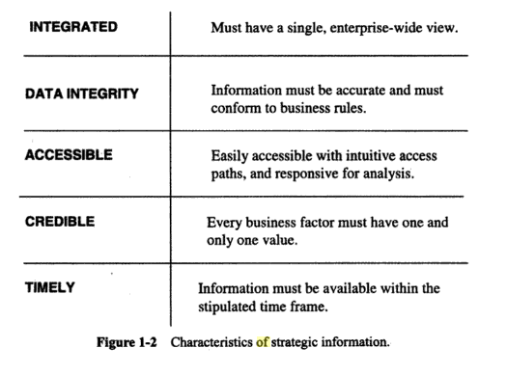
Information needed for formulating and executing business strategies and objectives is meant for the entire organization is called strategic information.
Characteristics of strategic information:

Slide 20
Inability of Past Decision support System:
Steps for providing Strategic Data:
1)User needs information
2)User requests report from IT
3)IT places request on backlog
4)IT creates ad hoc query .
5)IT sends requested report
6)User hopes to get the right answer.

Slide 21
Drawback:
Too many ad hoc request for a variety of query.
Need changes over time with users wanting more reports subsequently to expand
and understand earlier reports.
More supplementary reports increases the workload.
Environment is not flexible.

Slide 22
Decision Support System
A Decision Support System (DSS) is an interactive computer-based system or subsystem intended to help decision makers use communications technologies, data, documents, knowledge and/or models to identify and solve problems, complete decision process tasks, and make decisions.
Decision Support System is a general term for any computer application that enhances a person or group’s ability to make decisions.

Slide 23
Decision Support
Used to manage and control business
Data is historical or point-in-time
Optimized for inquiry rather than update
Use of the system is loosely defined and can be ad-hoc
Used by managers and end-users to understand the business and make judgements
‹#›

Slide 24
Expectations from the Decision support System:
Database designed for analyzing large volumes of data.
Data extracted from multiple applications.
User friendliness.
Intuitive to use for long interactive sessions by users.
Containing read intensive data usage that is stable in nature.
Enables easy usage of the system by the users without assistance from IT professionals.
Periodically updating of data contents.
Contains current as well as Historical data.
Ability for users to formulate and execute queries and get results online.

Slide 25
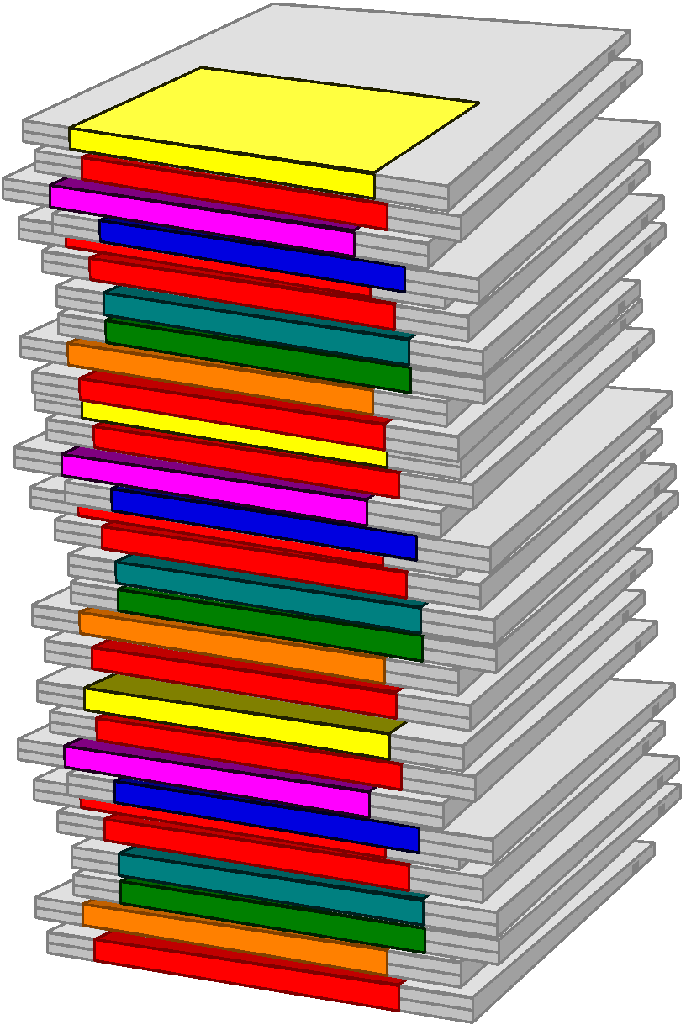
What is a Data Warehouse?
A single, complete and consistent store of data obtained from a variety of different sources made available to end users in a what they can understand and use in a business context.
[Barry Devlin]
‹#›

Slide 26
Inmons’s definition
What is Data Warehouse?
A data warehouse is a collection of integrated databases
designed to support a DSS.
A data warehouse is
-subject-oriented,
-integrated,
-time-variant,
-nonvolatile
collection of data in support of management’s decision making
process.

Slide 27

What is Data Warehousing?
A process of transforming data into information and making it available to users in a timely enough manner to make a difference
[Forrester Research, April 1996]
Information
Data
‹#›
Notes:
‹#›

Slide 28
Evolution
60’s: Batch reports
hard to find and analyze information
inflexible and expensive, reprogram every new request
70’s: Terminal-based DSS and EIS (executive information systems)
still inflexible, not integrated with desktop tools
80’s: Desktop data access and analysis tools
query tools, spreadsheets, GUIs
easier to use, but only access operational databases
90’s: Data warehousing with integrated OLAP engines and tools
‹#›
Notes:
‹#›

Slide 29
Very Large Data Bases
Terabytes -- 10^12 bytes:
Petabytes -- 10^15 bytes:
Exabytes -- 10^18 bytes:
Zettabytes -- 10^21 bytes:
Zottabytes -- 10^24 bytes:
Walmart -- 24 Terabytes
Geographic Information Systems
National Medical Records
Weather images
Intelligence Agency Videos
‹#›
Notes:
‹#›

Slide 30

Data Warehousing -- It is a process
Technique for assembling and managing data from various sources for the purpose of answering business questions. Thus making decisions that were not previous possible
A decision support database maintained separately from the organization’s operational database
‹#›
Notes:
‹#›

Slide 31
What can a data warehouse do?
Immediate information delivery
Integration of data from within and outside the organization
Provides an insight into the future
Enables users to look at the sate data in different ways
Provides freedom from the dependency on IT
‹#›
Notes:
‹#›

Slide 32
Data Warehouse Users:
Casual or novice user: Uses the data warehouse occasionally and needs a very intuitive information interface.
Regular user: Uses the data warehouse almost daily . These users are comfortable with computing options but can not create reports and queries on their own and thus make use of query templates and predefined reports.
Power users:
proficient with technology
Capable of creating reports and executing query.
Executives and Managers:
They need information for making high level strategic decisions.
They prefer customized and personalized reports.

Slide 33
Technical analyst:
They perform complex analysis and statistical analysis,perform drill down and rollup,slice and dice operations on data.
Business analyst:
Comfortable with technology.
They rely on predefined queries and reports to satisfy their requirement.

Slide 34
Benefits of Data Warehouse
DW enables end users to access wide variety of data.
Business analyst and decision makers can analyze the current trends in the market to predict future trends.
for example the analyst can analyze the products sales in particular area for the last
two years.This may helpful for future investment in a particular item.
DW provides consistent data.
It helps to increase the productivity and decrease the computing cost.
DW contains data that has been integrated from a number of sources.
The results obtained can be presented in variety of formats in the form of reports,graph etc.

Slide 35
DW users can obtain trend reports , for eg. The product that had maximum sale in Northern region within the last two years and exception report that shows actual performance versus goal.
DW enhances the value of the operational business applications.eg.CRM

Slide 36
DW are special types of databases that are specifically built for the propose of getting information out rather than putting data in.
DW provides answers to strategic questions and assist the managers of organizations in planning for the future .
The data warehouse is an informational environment that provides an integrated and total view of the enterprise.
Makes the enterprise’s current and historical information easily available for decision making.
Makes decision-support transactions possible without hindering operational systems.
Renders the organization’s information consistent.
Presents a flexible and interactive source of strategic information.

Slide 37
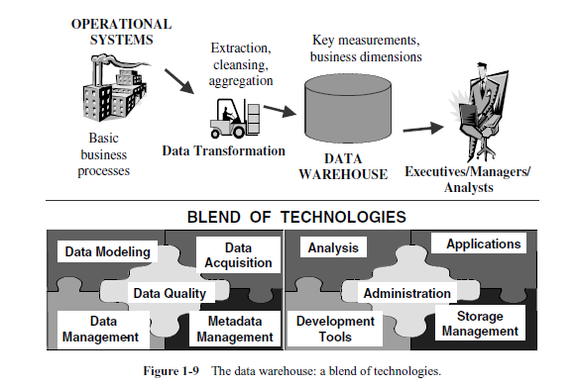
Although a simple concept, it involves different functions: data extraction, the function of loading the data, transforming the data, storing the data, and providing user interfaces.

Slide 38
Features of DW:
subject-oriented
integrated
time-varient
non-volatile

Slide 39
Subject-oriented
Data warehouses are designed to help you analyze your data.
Data warehouse is organized around subjects such as sales etc.
Subject-oriented means data are organized by business topic not by business processes.
For example, you might want to learn more about your company's sales data. To do this, you could build a warehouse concentrating on sales. In this warehouse, you could answer questions like "Who was our best customer for this item last year?" This kind of focus on a topic, sales in this case, is what is meant by subject oriented.

Slide 40
A data warehouse is subject oriented because it provides information around a subject rather than the organization's ongoing operations.
These subjects can be product, customers, suppliers, sales, revenue, etc.
A data warehouse does not focus on the ongoing operations, rather it focuses on modelling and analysis of data for decision making.

Slide 41
Data warehousing systems are generally subject-oriented, organized around business areas that the organization needs information about.
In DW subject is the organization method
Subjects vary with enterprise
These are critical factors, that affect performance
Such subject areas are usually populated with data from one or more operational systems.
As an example Claims is a critical business subject for an insurance company.
Sales for retail company etc.
Manufacturing Company
Sales
Shipment
Inventory etc.

Slide 42
Integration
A data warehouse is constructed by integrating data from heterogeneous sources such as relational databases, flat files, etc.
Data area stored as a single unit , not as a collection of files that may have different structures or organizations.
RDBMS
Data
Warehouse
Legacy
System
Flat File
Data Processing
Data Transformation

Slide 43
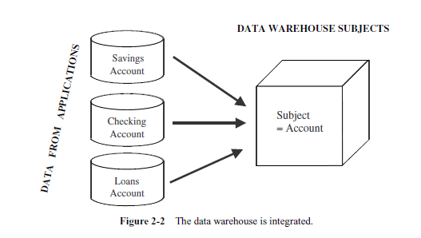
This integration enhances the effective analysis of data.
Data Preprocessing are applied to ensure consistency.

Slide 44
Data comes from several applications
Problems of integration comes into play
File layout, encoding, field names, systems, schema, data heterogeneity are the issues
Bank example, variance: naming convention, attributes for data item, account no, account type, size, currency
In addition to internal, external data sources
External companies data sharing
Websites
Others
Removal of inconsistency
Naming conventions
Codes
Data attributes
Measurements
So process of extraction, transformation & loading.

Slide 45
Time-variant
Time variant means that the time dimension is explicitly included in the data so that trends and changes over time can be studied.
Time variant simply means that the data available were identified on a particular period.
Every key structure contains either implicitly or explicitly an element of time.
Provides information from historical perspective e.g. past 5-10 years

Slide 46
Operational data has current values
Comparative analysis is one of the best techniques for business performance evaluation
Time is critical factor for comparative analysis.
Every data structure in DW contains time element.
In order to promote product in certain, analyst has to know about current and historical values
The advantages are
Allows for analysis of the past
Relates information to the present
Enables forecasts for the future

Slide 47
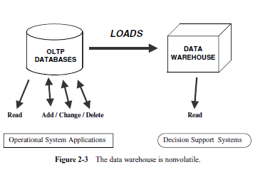
Nonvolatile
Data don’t keep changing. New data may be added on a schedule basis , but old data aren’t discarded.
Data once recorded cannot be updated.
Data warehouse requires two operations in data accessing
Initial loading of data
Access of data

Slide 48
Data from operational systems are moved into DW after specific intervals
Data is persistent/ not removed i.e. non volatile
Every business transaction don’t update in DW
Data from DW is not deleted
Data is neither changed by individual transactions

Slide 49
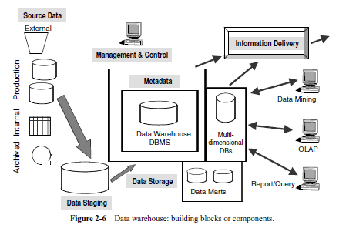
Data Warehouse components:

Slide 50
Components
Major components
Source data component
Data staging component
Information delivery component
Metadata component
Management and control component
‹#›
Notes:
‹#›

Slide 51
1. Source Data Components
Source data can be grouped into 4 components
Production data
This category of data comes from the various operational systems of the enterprise.
Based on the information requirements in the data warehouse, you choose
segments of data from the different operational systems.
While dealing with this data, you come across many variations in the data formats. You also notice that the data resides on different hardware platforms.
‹#›
Notes:
‹#›

Slide 52
Internal data
Private datasheet, documents, customer profiles etc.
E.g. Customer profiles for specific offering
Special strategies to transform ‘it’ to DW (text document)
Archived data
Old data is archived.
DW have snapshots of historical data.
External data
Executives depend upon external sources
E.g. market data of competitors, etc.
Most executives depend on data from external sources for a high percentage of the information they use.
They use statistics relating to their industry produced by external agencies.
They use market share data of competitors.
They use standard values of financial indicators for their business to check on their performance.

Slide 53
2. Data Staging Components
After data is extracted from various operational systems and from external
sources, you have to prepare the data for storing in the data warehouse.
The extracted data coming from several disparate sources needs to be changed, converted, and made ready in a format that is suitable to be stored for querying and analysis.
Three major functions to make data ready
Extract
Transform
Load
These three major functions of extraction, transformation, and preparation for loading take place in a staging area.
The data staging component consists of a workbench for these
functions
‹#›
Notes:
‹#›

Slide 54
Data staging provides a place and an area with a set of functions to clean,
change, combine, convert, DE duplicate, and prepare source data for storage
and use in the data warehouse.
Data Extraction. This function has to deal with numerous data sources. You have to employ the appropriate technique for each data source.
Source data may be from different source machines in diverse data formats. Part of the source data may be in relational database systems.
Some data may be on other legacy network and hierarchical data models.
Many data sources may still be in flat files. You may want to include data from
spreadsheets and local departmental data sets. Data extraction may become quite complex.
Staging area provides a place and area with a set of functions to
Clean
Change
Combine
Convert

Slide 55
Data Transformation. In every system implementation, data conversion is an important function.
You perform a number of individual tasks as part of data transformation.
First, you clean the data extracted from each source.
Cleaning may just be correction of misspellings, or may include resolution of conflicts between state codes and zip codes in the source data, or may deal with providing default values for missing data elements, or elimination of duplicates when you bring in the same data from multiple source systems.

Slide 56
Standardization of data elements forms a large part of data transformation. You standardize the data types and field lengths for same data elements retrieved from the various sources.
Semantic standardization is another major task.
You resolve synonyms and homonyms.
When two or more terms from different source systems mean the same thing,
you resolve the synonyms.
When a single term means many different things in different source systems, you resolve the homonym.

Slide 57
Data transformation involves many forms of combining pieces of data from the different sources.
You combine data from a single source record or related data elements from
many source records.
On the other hand, data transformation also involves purging source data that is not useful and separating out source records into new combinations.
Sorting and merging of data takes place on a large scale in the data staging area.

Slide 58
Data Loading.
Two distinct groups of tasks form the data loading function.
When you complete the design and construction of the data warehouse and go live for the first time , you do the initial loading of the data into the data warehouse storage.
The initial load moves large volumes of data using up substantial amounts of time.
As the data warehouse starts functioning, you continue to extract the changes to the source data, transform the data revisions, and feed the incremental data revisions on an ongoing basis is called incremental load.

Slide 59
3. Data Storage Components
Separate repository
Data structured for efficient processing
Updated after specific periods
Only read-only.
Many of the data warehouses also employ multidimensional database management
systems.
Data extracted from the data warehouse storage is aggregated in many ways and
the summary data is kept in the multidimensional databases (MDDBs).
Such multidimensional database systems are usually proprietary products.
‹#›
Notes:
‹#›

Slide 60
4. Information Delivery Component
In order to provide information to the wide community of data warehouse users, the information delivery component includes different methods of information delivery.
Different information delivery methods:
Ad hoc reports are predefined reports primarily meant for novice and casual users.
Provision for complex queries, multidimensional (MD) analysis, and statistical analysis cater to the needs of the business analysts and power users.
Information fed into Executive Information Systems (EIS) is meant for senior executives and high-level managers.
Some data warehouses also provide data to data-mining applications. Data-mining applications are knowledge discovery systems.
‹#›
Notes:
‹#›

Slide 61
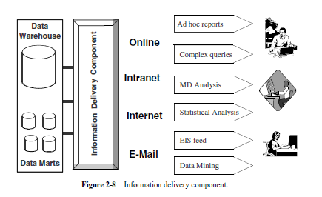

Slide 62
Metadata
Metadata in a data warehouse is similar to the data dictionary or the data catalog in a database management system.
In the data dictionary, you keep the information about the logical data structures, the information about the files and addresses, the information about the indexes, and so on.
The data dictionary contains data about the data in the database.
Metadata in data warehouse defines the warehouse objects.
Metadata acts as a directory. This directory helps the decision support system to locate the contents of a data warehouse.

Slide 63
Types of Metadata
Metadata in a data warehouse fall into three major categories:
Operational Metadata
Extraction and Transformation Metadata
End-User Metadata
Operational Metadata.
Data for the data warehouse comes from several operational systems of the enterprise.
These source systems contain different data structures.
The data elements selected for the data warehouse have various field lengths and data types.
In selecting data from the source systems for the data warehouse, you split records , combine parts of records from different source files, and deal with multiple coding schemes and field lengths.
When you deliver information to the end-users, you must be able to tie that back to the original source data sets.
Operational metadata contain all of this information about the operational data sources.

Slide 64
Extraction and Transformation Metadata:
Extraction and transformation metadata contain data about the extraction of data from the source systems, namely, the extraction frequencies, extraction methods, and business rules for the data extraction.
Also, this category of metadata contains information about all the data transformations that take place in the data staging area.
End-User Metadata.
The end-user metadata is the navigational map of the data warehouse.
It enables the end-users to find information from the data warehouse.
The end-user metadata allows the end-users to use their own business terminology and look for information in those ways in which they normally think of the business.

Slide 65
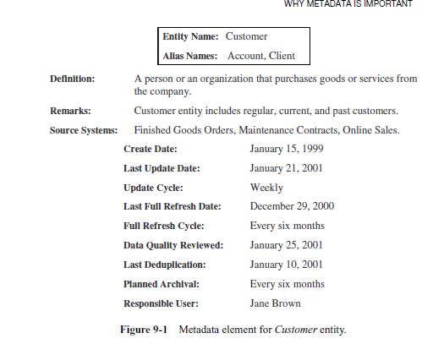

Slide 66
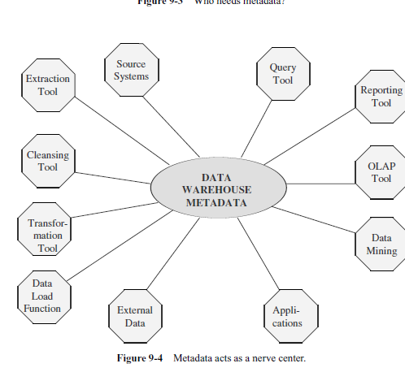

Slide 67
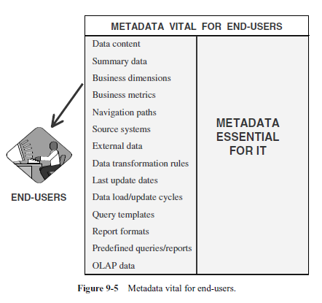

Slide 68
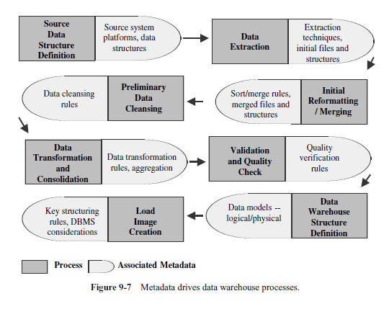

Slide 69
Data warehouse processes shown in the order
1. Source data structure definition
2. Data extraction
3. Initial reformatting/merging
4. Preliminary data cleansing
5. Data transformation and consolidation
6. Validation and quality check
7. Data warehouse structure definition
8. Load image creation

Slide 70
Why is metadata especially important in a data warehouse?
First, it acts as the glue that connects all parts of the data warehouse.
Next, it provides information about the contents and structures to the developers.
Finally, it opens the door to the end-users and makes the contents recognizable in
their own terms.

Slide 71
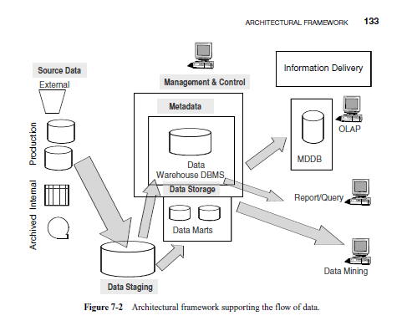
Flow of Data in Data Warehouse:

Slide 72
At the Data Source.
Source data governs the extraction of data for preparation and storage in the data warehouse.
The data staging architectural component governs the transformation, cleansing, and integration of data.
In the Data Warehouse Repository.
The data storage architectural component includes the loading of data from the staging area and also storing the data in suitable formats for information delivery.
The metadata architectural component is also a storage mechanism to contain data about the data at every point of the flow of data from beginning to end.
At the User End.
The information delivery architectural component includes dependent data marts, special multidimensional databases, and a full range of query and reporting facilities.

Slide 73
The Management and Control Module
This component has two major functions:
first to constantly monitor all the ongoing operations, and next to step in and recover from problems when things go wrong.

Slide 74
TECHNICAL ARCHITECTURE of DW

Slide 75
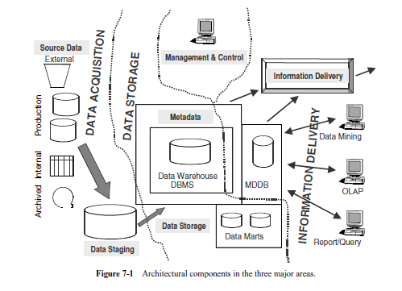
THE ARCHITECTURAL COMPONENTS:
The structure that brings all the components of a data warehouse together is known as the architecture.

Slide 76
the three major areas in the data warehouse are:
Data acquisition
Data storage
Information delivery

Slide 77
Data Acquisition
This area covers the entire process of extracting data from the data sources, moving all the extracted data to the staging area, and preparing the data for loading into the data warehouse repository.
The two major architectural components identified earlier as part of this area are source data and data staging.
The functions and services in this area relate to these two architectural components

Slide 78
Data Flow
Flow. In the data acquisition area, the data flow begins at the data sources and pauses at the staging area. After transformation and integration, the data is ready for loading into the data warehouse repository.
Data Sources. For the majority of data warehouses, the primary data source consists of the enterprise’s operational systems.
Many of the operational systems at several enterprises are still legacy systems. Legacy data resides on hierarchical or network databases.
Extract data from these databases by using respective language of DBMS.
Some of the more recent operational systems run on the client/server architecture.
Usually, these systems are supported by relational DBMSs.
Here you may use an SQL-based language for extracting data.

Slide 79
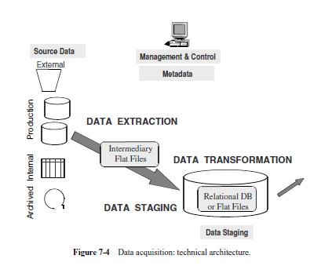

Slide 80
Intermediary Data Stores. As data gets extracted from the data sources, it moves
through temporary files.
Sometimes, extracts of homogeneous data from several source applications are pulled into separate temporary files and then merged into another temporary
file before moving it to the staging area.

Slide 81
Staging Area.
This is the place where all the extracted data is put together and prepared for loading into the data warehouse.
The staging area is like an assembly plant or a construction area.
In this area, you examine each extracted file, review the business rules,
perform the various data transformation functions, sort and merge data, resolve
inconsistencies, and cleanse the data.
When the data is finally prepared either for an enterprise wide data warehouse or one of the conformed data marts, the data temporarily resides in the staging area repository awaiting to be loaded into the data warehouse repository.

Slide 82
Functions:
Data Extraction
Select data sources and determine the types of filters to be applied to individual
sources Generate automatic extract files from operational systems using replication
and other techniques
Create intermediary files to store selected data to be merged later
Transport extracted files from multiple platforms
Provide automated job control services for creating extract files
Reformat input from outside sources
Reformat input from departmental data files, databases, and spreadsheets
Generate common application code for data extraction
Resolve inconsistencies for common data elements from multiple sources

Slide 83
Data Transformation
Map input data to data for data warehouse repository
Clean data, de-duplicate, and merge/purge.
De-normalize extracted data structures as required by the dimensional model of the data warehouse
Convert data types
Calculate and derive attribute values
Check for referential integrity
Aggregate data as needed
Resolve missing values
Consolidate and integrate data

Slide 84
Data Staging
Provide backup and recovery for staging area repositories
Sort and merge files
Create files as input to make changes to dimension tables
If data staging storage is a relational database, create and populate database
Preserve audit trail to relate each data item in the data warehouse to input source
Resolve and create primary and foreign keys for load tables
Consolidate datasets and create flat files for loading through DBMS utilities
If staging area storage is a relational database, extract load files

Slide 85
Data Storage
This area covers the process of loading the data from the staging area into the data warehouse repository.
All functions for transforming and integrating the data are completed in
the data staging area.
The prepared data in the data warehouse is like the finished product that is ready to be stacked in an industrial warehouse.
Data Flow
Flow. For data storage, the data flow begins at the data staging area. The transformed
and integrated data is moved from the staging area to the data warehouse repository.

Slide 86
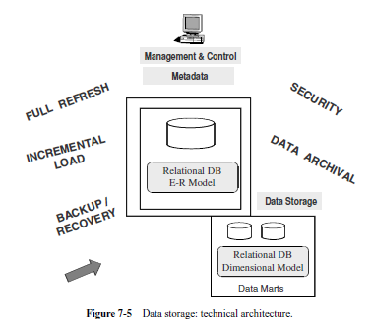

Slide 87
List of Functions and Services
Load data for full refreshes of data warehouse tables
Perform incremental loads at regular prescribed intervals
Support loading into multiple tables at the detailed and summarized levels
Optimize the loading process
Provide automated job control services for loading the data warehouse
Provide backup and recovery for the data warehouse database
Provide security
Monitor and fine-tune the database
Periodically archive data from the database according to preset conditions

Slide 88
Information Delivery
This area spans a broad spectrum of many different methods of making information available to users.
For your users, the information delivery component is the data warehouse.
They do not come into contact with the other components directly.
For the users, the strength of your data warehouse architecture is mainly concentrated in the robustness and flexibility of the information delivery component.

Slide 89
Flow. For information delivery, the data flow begins at the enterprise-wide data warehouse and the dependent data marts when the design is based on the top-down technique.
When the design follows the bottom-up method, the data flow starts at the set of conformed data marts.

Slide 91
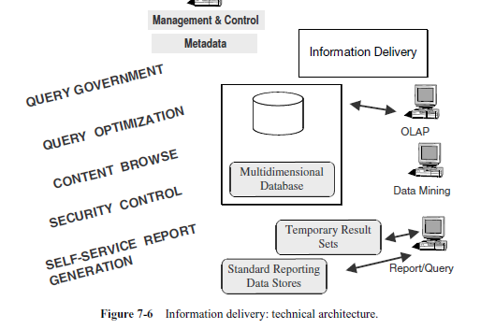

Slide 92
Functions:
Provide security to control information access
Monitor user access to improve service and for future enhancements
Allow users to browse data warehouse content
Simplify access by hiding internal complexities of data storage from users.
Automatically reformat queries for optimal execution
Enable queries to be aware of aggregate tables for faster results
Govern queries and control runaway queries
Provide self-service report generation for users, consisting of a variety of flexible
options to create, schedule, and run reports
Store result sets of queries and reports for future use
Provide multiple levels of data granularity
Provide event triggers to monitor data loading
Make provision for the users to perform complex analysis through online analytical processing (OLAP)
Enable data feeds to downstream, specialized decisions support systems such as EIS
and data mining

Slide 93
Data Warehouse: A Multi-Tiered Architecture
Monitor
&
Integrator
OLAP Server
Other
sources
Metadata
Analysis
Query
Reports
Data mining
Operational
DBs
Extract
Transform
Load
Refresh
Data
Warehouse
Serve
Data Marts
Data Sources
Data Storage
OLAP Engine
Front-End Tools
*
Data Mining: Concepts and Techniques
Notes:
‹#›

Slide 94
Data Warehouse :A multitiered Architecture
Warehouse Database Server
It’s a bottom tier data warehouse
Always RDBMS.
Back-end tools and utilities are used to feed data into the bottom tier form operational DB or other external sources.
The data are extracted using application program interface known as Gateways
OLAP Server
Special purpose server which directly implement multidimentional data and opreations.
ROLAP, MOLAP, HOLAP
Front-end client layer
It contains query and reporting tools or DM tolls(e.g trend analysis, prediction etc.)
*
‹#›
Notes:
‹#›

Slide 95
Architecture of DW
Information Sources
Data Warehouse
Server
(Tier 1)
OLAP Servers
(Tier 2)
Clients
(Tier 3)
e.g., MOLAP
Analysis
Semistructured
Sources
Data
Warehouse
serve
extract
transform
load
refresh
Query/Reporting
serve
e.g., ROLAP
Operational
DB’s
serve
Data Mining
Staging area
Data Marts
‹#›
Notes:
‹#›

Slide 96
Data Mart
Subset of the enterprise wide data warehouse.
A data mart is the access layer of the data warehouse environment that is used to get data out to the users.
Departmental data from Data Warehouse is called Data Mart.
Eg. Finance Department Data mart
Sales Department Data Mart
Marketing Department Data Mart.
‹#›
Notes:
‹#›

Slide 97
Reasons :
To enable access to the data the department needs to analyze most frequently.
To improve end users response time and to reduce volume of data to be accessed.
Data marts uses less data , so tasks such as cleansing, loading , transformation and integration are easier.
Implementation Data Mart is simpler.

Slide 98
Advantages:
The cost is low.
Required time to implementation is short.
Controlled locally rather than centrally.
They contains less information.
Reduce network traffic

Slide 99
Limitations:
Performance Degradation as size of the data mart increases.
Administration becomes difficult.
Issues in accessing remote Data Mart.

Slide 100
Data Warehouse
Corporate/Enterprise-wide
Combination of all data marts
Data received from staging area
Structure for corporate view of data
Low level of granularity.
Takes Months to years to implement.
Data Warehouse size varies from 100 GB to TB.
Flexible Query and Analysis.
Data Mart
Departmental
A single business process
Star join (facts & dim.)
Structure to suit the departmental view of data.
High level of granularity.
Takes months to implement.
Data Mart size is less than GB.
Restrictive Query and Analysis.
‹#›
Notes:
‹#›

Slide 101
Data Warehouse Design Approaches
Data warehouse design is one of the key technique in building the data warehouse.
Choosing a right data warehouse design can save the project time and cost.
Basically there are two data warehouse design approaches are popular.
1. Bottom up design
2. Top Down Design

Slide 102
Top-Down approach Warehouse
Data Sources
Data Warehouse
Data Marts
‹#›
Notes:
‹#›

Slide 103
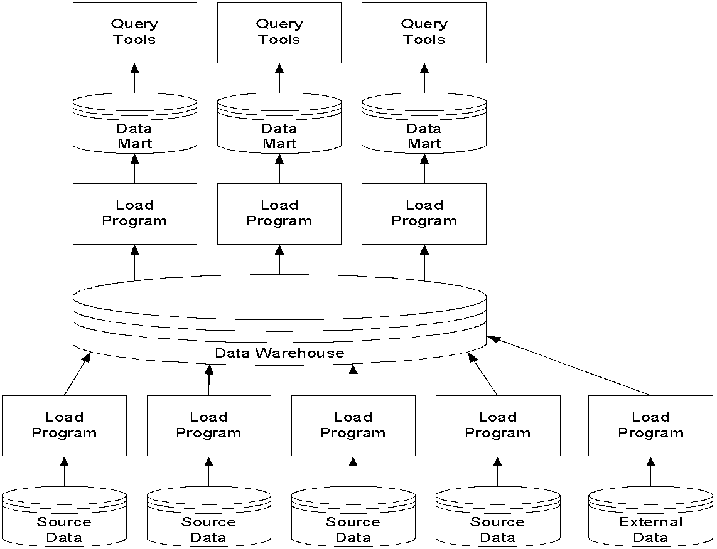
‹#›

Slide 104
In the top-down design approach the, data warehouse is built first. The data marts are then created from the data warehouse. Advantages of top-down design are:
Provides consistent dimensional views of data across data marts, as all data marts are loaded from the data warehouse.
This approach is robust against business changes. Creating a new data mart from the data warehouse is very easy.
Disadvantages of top-down design are:
This methodology is inflexible to changing departmental needs during implementation phase.
It represents a very large project and the cost of implementing the project is significant.

Slide 105
Bottom-up approach
In the bottom-up approach, data marts are first created to provide reporting and analytical capabilities for specific business processes.
The single data mart often models a specific business area such as "Sales" or "Production."
These data marts can eventually be integrated to create a comprehensive data warehouse.
‹#›
Notes:
‹#›

Slide 106
Bottom-up approach Warehouse
Data Sources
Data Marts
Data Warehouse
‹#›
Notes:
‹#›

Slide 107
In the bottom-up design approach, the data marts are created first to provide reporting capability.
A data mart addresses a single business area such as sales, Finance etc.
These data marts are then integrated to build a complete data warehouse.
The integration of data marts is implemented using data warehouse bus architecture.
In the bus architecture, a dimension is shared between facts in two or more data marts.
These dimensions are called conformed dimensions.
These conformed dimensions are integrated from data marts and then data warehouse is built.

Slide 108
Advantages of bottom-up design are: This model contains consistent data marts and these data marts can be delivered quickly.
As the data marts are created first, reports can be generated quickly.
The data warehouse can be extended easily to accommodate new business units. It is just creating new data marts and then integrating with other data marts.

Slide 109

What are Operational Systems?
They are OLTP systems
Run mission critical applications
Used to run a business!
‹#›
Notes:
‹#›

Slide 110
RDBMS used for OLTP
Database Systems have been used traditionally for OLTP
clerical data processing tasks
detailed, up to date data
structured repetitive tasks
read/update a few records
isolation, recovery and integrity are critical
‹#›
Notes:
‹#›

Slide 111

Operational Systems
Run the business in real time
Based on up-to-the-second data
Optimized to handle large numbers of simple read/write transactions
Optimized for fast response to predefined transactions
Used by people who deal with customers, products -- clerks, salespeople etc.
They are increasingly used by customers
‹#›
Notes:
‹#›

Slide 112
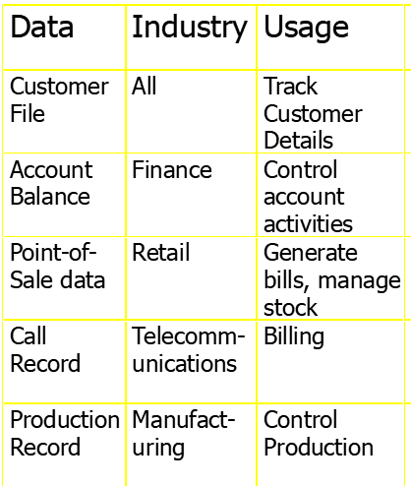
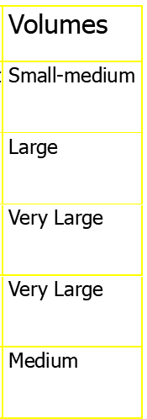
Examples of Operational Data
‹#›
Notes:
‹#›

Slide 113
OLTP vs. Data Warehouse
OLTP systems are tuned for known transactions and workloads while workload is not known a priori in a data warehouse
Special data organization, access methods and implementation methods are needed to support data warehouse queries (typically multidimensional queries)
e.g., average amount spent on phone calls between 9AM-5PM in Pune during the month of December
‹#›
Notes:
‹#›

Slide 114
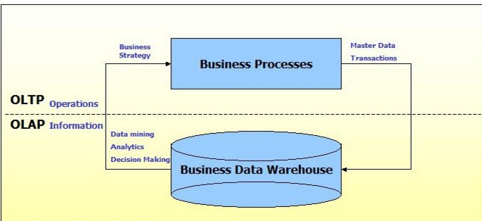
OLTP vs. OLAP We can divide IT systems into transactional (OLTP) and analytical (OLAP). In general we can assume that OLTP systems provide source data to data warehouses, whereas OLAP systems help to analyze it.

Slide 115
OLTP vs Data Warehouse
Warehouse (DSS)
Subject Oriented
Used to analyze business
Summarized and refined
Snapshot data
Integrated Data
Ad-hoc access
Knowledge User (Manager)
OLTP
Application Oriented
Used to run business
Detailed data
Current up to date
Isolated Data
Repetitive access
Clerical User
‹#›
Notes:
‹#›

Slide 116
OLTP vs Data Warehouse
OLTP
Performance Sensitive
Few Records accessed at a time (tens)
Read/Update Access
No data redundancy
Database Size 100MB -100 GB
Data Warehouse
Performance relaxed
Large volumes accessed at a time(millions)
Mostly Read (Batch Update)
Redundancy present
Database Size 100 GB - few terabytes
‹#›
Notes:
‹#›

Slide 117
OLTP vs Data Warehouse
OLTP
Transaction throughput is the performance metric
Thousands of users
Managed in entirety
Data Warehouse
Query throughput is the performance metric
Hundreds of users
Managed by subsets
‹#›
Notes:
‹#›

Slide 118
Comparision of OLTP And OLAP Systems
Feature | OLTP | OLAP
Characteristic | Operational Processing | Informational Processing
Orientation | Transaction | Analysis
User | Cleark, DBA, Database professional | Knowledge worker(E.g Manager, executive, analyst)
Function | Day-to-day operations | Long-term informational requirements decision support
DB design | ER-based, application-oriented | Star/snowflake, subject oriented
Data | Current, guaranteed up-to-date | Historic, accuracy maintained over time
Summarization | Primitive, highly detailed | Summarized, consolidated
‹#›
Notes:
‹#›

Slide 119
Comparision of OLTP And OLAP Systems
Feature | OLTP | OLAP
View | Detailed | Summarized, multidimentional
Unit of work | Short, simple transation | Complex query
Access | Read/write | Mostly read
Focus | Data in | Information out
Operations | Index/hash on primary key | Lots of scans
Number of records accessed | tens | millions
Number of users | Thousand | Hundreds
Priority | High performance, high availability | High flexibility, end –user autonomy
DB size | GB | >= TB
‹#›
Notes:
‹#›

Slide 120
Data Granularity
Data Granularity refers to the level of details .
DW keep data summarized at different levels.
E.g. Sales of data, Account data
‹#›
Notes:
‹#›

Slide 121
Data Granularity
High level of detail – low level of granularity
e.g. detail of phone call
Low level of detail – high level of granularity
e.g. summary of phone call
Data
warehouse
Data
warehouse
‹#›
Notes:
‹#›

Slide 122
Granularity
Granularity refers to the level of detail or summarization held in the units of data in the DW
Lower level of Granularity ---> more detail - transaction data
High level of Granularity ----> less detail - summarized data
High level of Granularity needs
Less space - few bytes of data and fewer index entries
Less processing resources
Notes:
‹#›

Slide 123
Granularity and Data Analysis
LOW LEVEL OF GRANULARITY
HIGH LEVEL OF GRANULARITY
HIGH LEVEL
OF DETAIL
LOW LEVEL
OF DETAIL
The details of every phone call made
by a customer for a month
The summary of phone calls made
by a customer for a month
40,000 bytes per month
200 records per month
200 bytes
1 record per month
The level of granularity is determined by what questions/queries
can be answered and what resources are required to answer a question
Notes:
‹#›

